Slide 1
Proof of Replication From Depth Robust Graphs
Ben Fisch
Stanford University
Joseph Bonneau
NYU
Juan Benet and Nicola Greco
Protocol Labs

Slide 2
Centralized Cloud Storage
Notes:
Massive amount of data being generated and stored in data centers

Slide 3
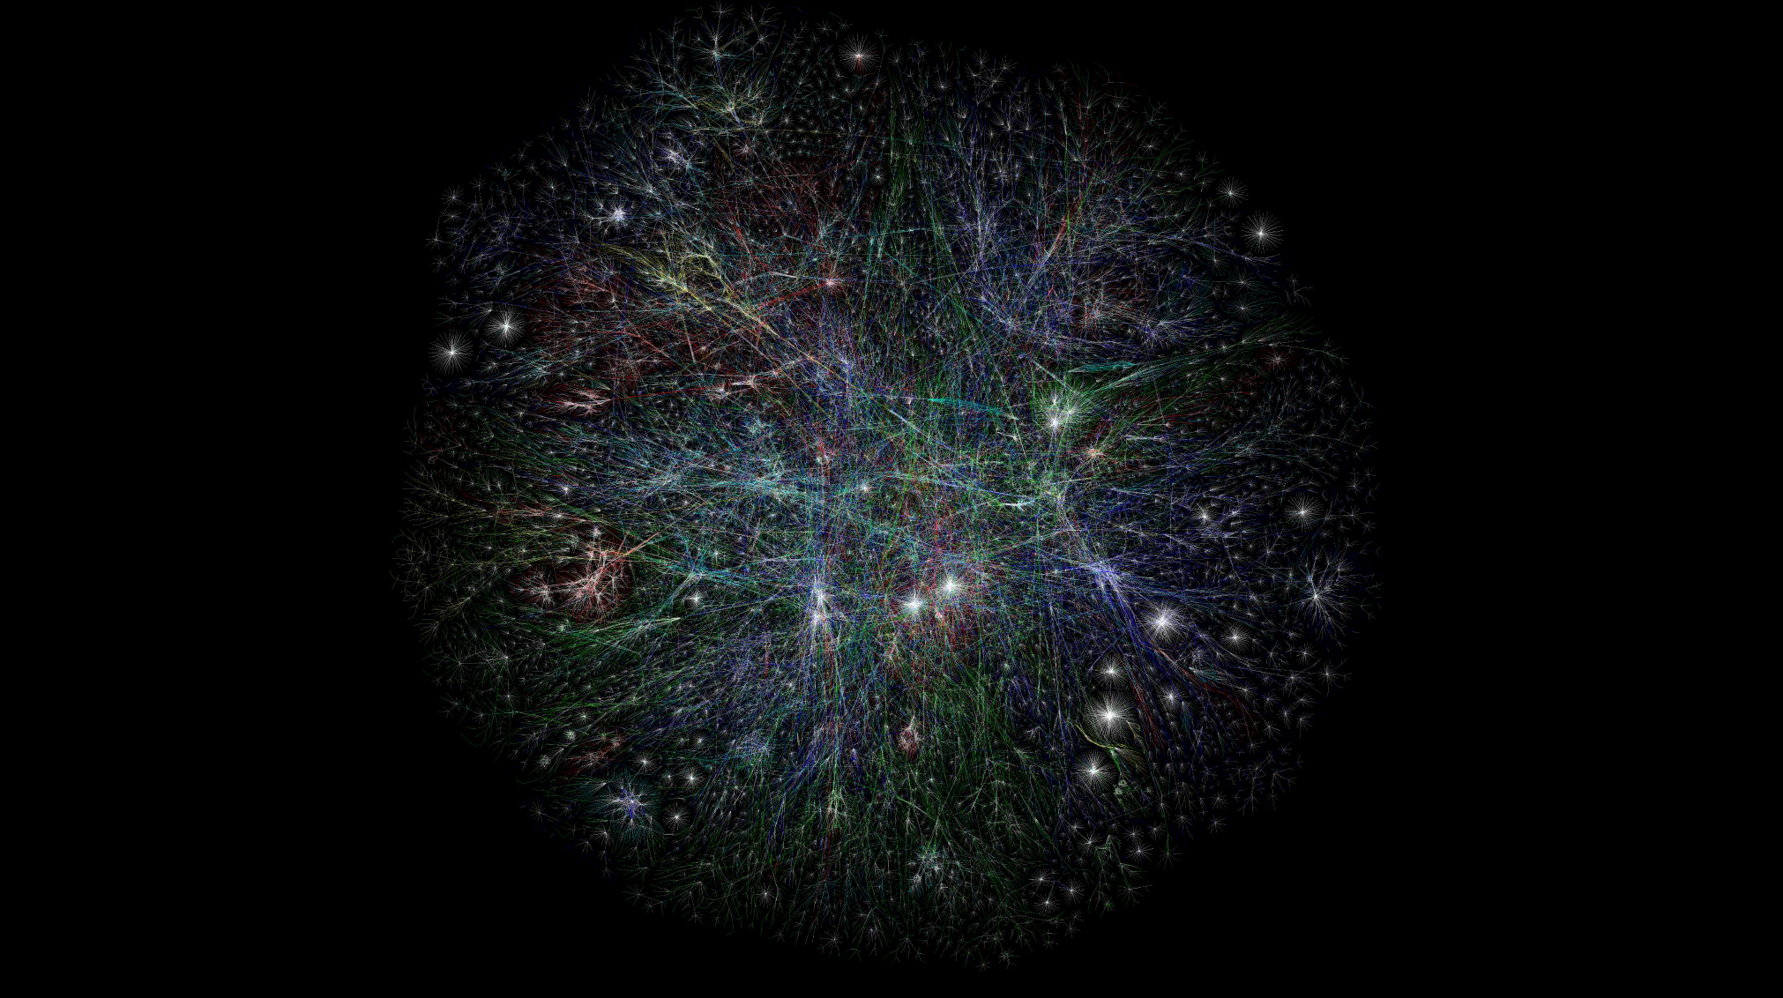
Notes:
Internet also scaled, massive amounts of unused storage, e.g. GBytes in everyone’s pockets

Slide 4
Decentralized File Storage

Slide 5
P2P File Download

Slide 6
Decentralized File Storage

Slide 7
Incentivize
Data Storage?
Is my data being stored?
Notes:
This is where these questions really matter….maybe you can trust a cloud storage company, but you can’t trust the wide open web

Slide 8
Internally ensure files are still being stored

Slide 9
Proofs of Storage
Proof of data possession (PDP)
Proof
of retrievability
(PoRet)
Proof
of
Spacetime
(PoSt)
Proof
of space
(PoSpace)
[Dziembowski et.al. 2015]
[Ateniese et. al. 2007]
[Benet et.
al. 2017]
[Juels et.al. 2007]

Slide 10
Incentives to store files
also create incentives to cheat
Proof of
Storage
Notes:
What kind of proof of storage do we need?

Slide 11
“Data Generation Attack”
Generate large amount of junk data on the fly from small seed
Proof of
Storage

Slide 12
Proof that you are dedicating unique resources to storing data even if you can generate all the data from a small seed
The need to use same amount of resources removes incentive to “cheat”

Slide 13
Proof that you are dedicating unique resources to storing N replicas of a file even if you know the file

Slide 14
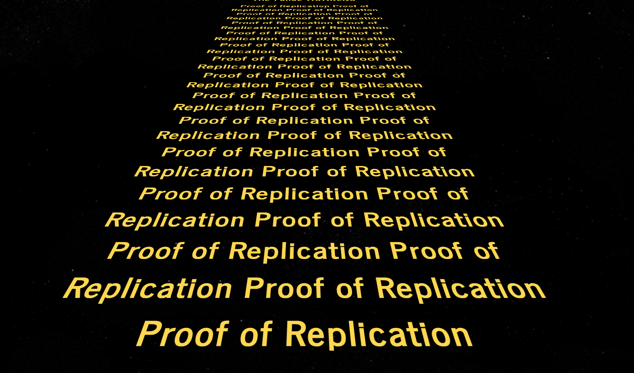

Slide 15
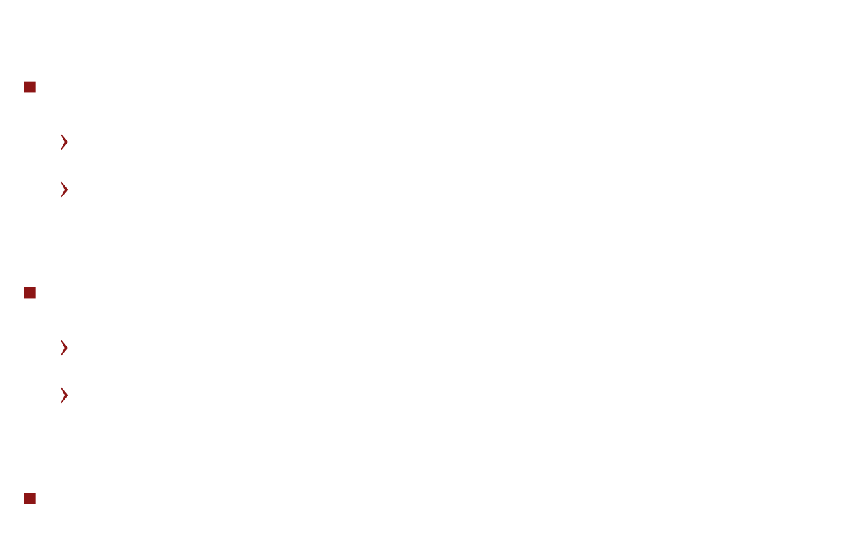
Proof of Replication: Towards a Cryptographic Definition
PoRep.Setup($1^{λ}, id, D$) $→R_{id}$, ${com}_{D}$
Setup generates replica $R_{id}$
${com}_{D}$ - commitment to data D
PoRep.Prove($R, id, c$) $→π_{}$
Takes in a challenge c
Outputs proof of storage of $R_{id}$
PoRep.Verify($id, c, com_{D}, π$) $→\{Accept, Reject\}$

Slide 16
Setup
Attacker must fail if it isn’t storing replica

Slide 17







Towards a Cryptographic Definition Security
$$Com_{D}$$
Adversary
Setup phase
Challenger
Encode(D, id)
$$Time$$
$$c$$
id
Challenge phase
$$π, id$$
Verify($id, c, com_{D}, π$)
$$\{Accept, Reject\}$$

Slide 18
Towards a Cryptographic Definition 1. Retrievability
$$Com_{D}$$
Adversary
Setup phase
Challenger
Encode(D, id)
$$Time$$
$$c$$
id
Challenge phase
Extractor
$$π, id$$
Verify($id, c, com_{D}, π$)
$$\{Accept, Reject\}$$
D

Slide 19

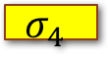
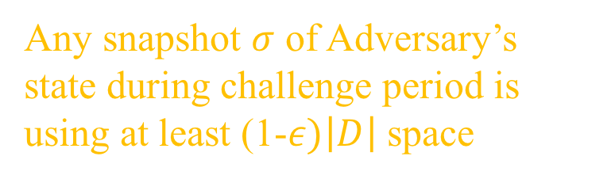
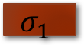
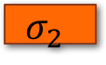
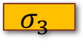
Towards a Cryptographic Definition 2. Space
Adversary
Setup phase
Challenger
Encode(D, id)
$$Time$$
id
$$σ_{1}$$
Challenge phase
$$σ_{2}$$
$$σ_{3}$$
$$σ_{4}$$
Any snapshot $σ$ of Adversary’s state during challenge period is using at least (1-$ε)\left|D\right|$ space

Slide 20
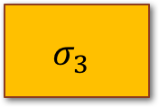
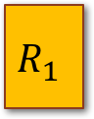
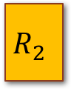
Towards a Cryptographic Definition 3. Replication
Adversary
Setup phase
Challenger
Encode(D, id)
$$Time$$
id1
id2
$$σ_{1}$$
Challenge phase
$$σ_{2}$$
$$σ_{3}$$
$$σ_{4}$$
$$σ_{3}$$
$$R_{1}$$
$$R_{2}$$

Slide 21


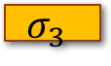
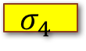

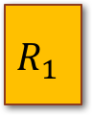
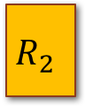

Towards a Cryptographic Definition 3. Replication
Any snapshot $σ$ of Adversary’s state can be partitioned into two parts
from each we can independently extract the data file
$$σ_{1}$$
$$σ_{2}$$
$$σ_{3}$$
$$σ_{4}$$
$$σ_{3}$$
$$R_{1}$$
$$R_{2}$$
Encode(D, id)
Data Extraction
D
D

Slide 22
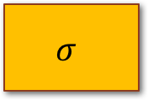
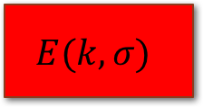
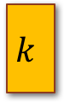
Towards a Cryptographic Definition Impossibility of Strongest Replication Definition
Encrypt
Cannot partition into parts that each independently encode data
$$σ$$
$$E(k, σ)$$
$$k$$
Decode and run successful strategy
Strategy
Succeed
Notes:
Not same proof of space notion as Bram presented yesterday, that is stronger. Time access here. Bram’s PoS require certain amount of space to produce, regardless of a time access.

Slide 23
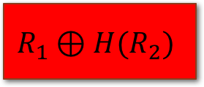
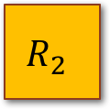
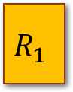
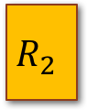
Towards a Cryptographic Definition Impossibility of Strongest Replication Definition
$$R_{1}$$
$$R_{2}$$
Cannot partition into parts that each independently encode data
$$σ$$
$$R_{1}⊕H(R_{2})$$
$$R_{2}$$
Decode and run successful strategy
Strategy
Succeed
Notes:
Not same proof of space notion as Bram presented yesterday, that is stronger. Time access here. Bram’s PoS require certain amount of space to produce, regardless of a time access.

Slide 24
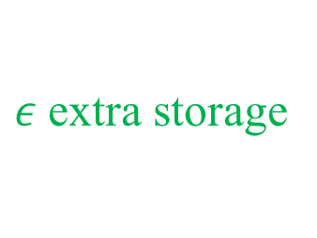
Towards a Cryptographic Definition Rational Adversary
“Good” strategies
Satisfy Strong Replication
$ε$extra storage
Negligible benefit
For any Adversary strategy, efficient way to switch to a “Good” strategy with negligible resource costs
at any point in time
Notes:
Not same proof of space notion as Bram presented yesterday, that is stronger. Time access here. Bram’s PoS require certain amount of space to produce, regardless of a time access.

Slide 25
Proof of Replication Goals
Scalability
Maintains security and performance for arbitrarily large files
Low communication
Compact proofs (smaller than file size)
Infrequent polling
Fast verification
Low complexity verification
Much faster than polling period / setup time
Notes:
Not same proof of space notion as Bram presented yesterday, that is stronger. Time access here. Bram’s PoS require certain amount of space to produce, regardless of a time access.

Slide 26

Basic Proof of Replication
Main tool: verifiable time-delay encoding
Type of Verifiable Delay Function!
AES(KDF(id), D) → R_{id}
Iterate many times
Not fast to decode
Slow Encode
Fast Decode
Notes:
Not same proof of space notion as Bram presented yesterday, that is stronger. Time access here. Bram’s PoS require certain amount of space to produce, regardless of a time access.

Slide 27
Basic Proof of Replication
$$Com_{D}$$
Prover
Setup phase
Verifier
Encode
Encode(D, id)
$$c$$
id
Challenge phase
id
Server cannot respond quickly
enough if deletes encoded replica
Decode
Decode

Slide 28
What about large files?
Encode separately each block?
Apply erasure code to file before breaking into blocks
Verification: query for randomly sampled number of blocks to gain confidence that 90% of blocks are being stored
Notes:
Not same proof of space notion as Bram presented yesterday, that is stronger. Time access here. Bram’s PoS require certain amount of space to produce, regardless of a time access.

Slide 29
What about large files?
Encode separately each block?
Initialization very expensive (each encoding takes a long time!)
Highly parallelizable for Adversary!
Notes:
Not same proof of space notion as Bram presented yesterday, that is stronger. Time access here. Bram’s PoS require certain amount of space to produce, regardless of a time access.

Slide 30
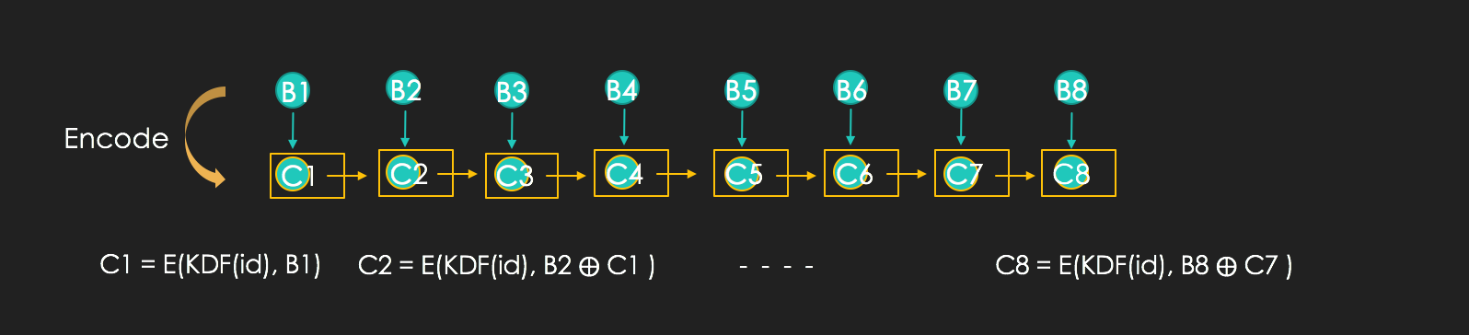
CBC Stream Encoding
Adjust delay on each encoding (#iterations) so total time of N encodings remains the same
Notes:
Not same proof of space notion as Bram presented yesterday, that is stronger. Time access here. Bram’s PoS require certain amount of space to produce, regardless of a time access.

Slide 31
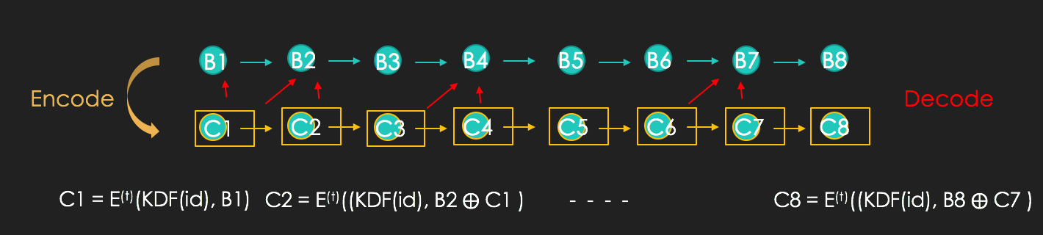
CBC Stream Encoding
Verifier randomly selects subset of blocks to decode
Notes:
Not same proof of space notion as Bram presented yesterday, that is stronger. Time access here. Bram’s PoS require certain amount of space to produce, regardless of a time access.

Slide 32
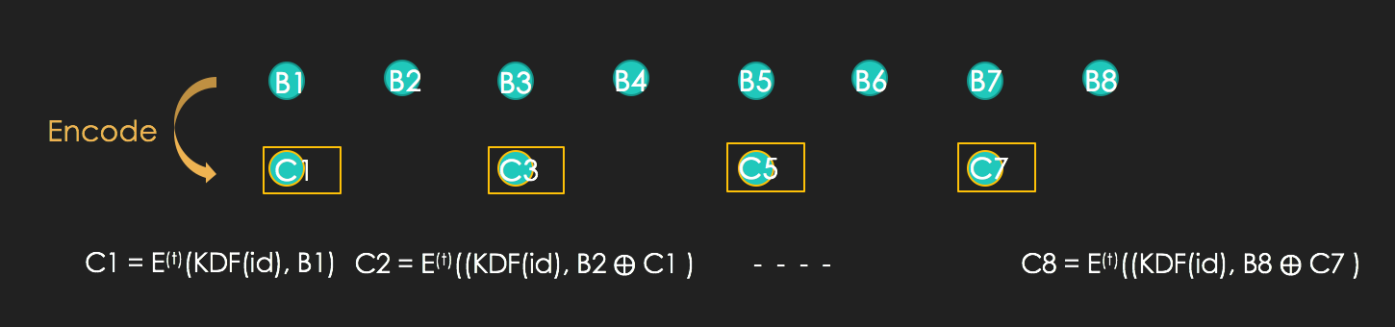
CBC Stream Encoding Attack!
Verifier randomly selects subset of blocks to decode
Notes:
Not same proof of space notion as Bram presented yesterday, that is stronger. Time access here. Bram’s PoS require certain amount of space to produce, regardless of a time access.

Slide 33
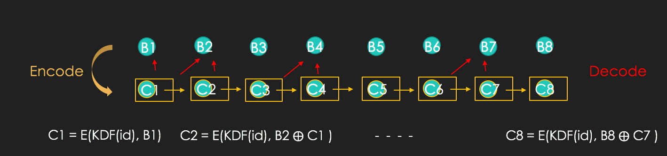
CBC Stream Encoding Attack!
Verifier randomly selects subset of blocks to decode
Notes:
Not same proof of space notion as Bram presented yesterday, that is stronger. Time access here. Bram’s PoS require certain amount of space to produce, regardless of a time access.

Slide 34
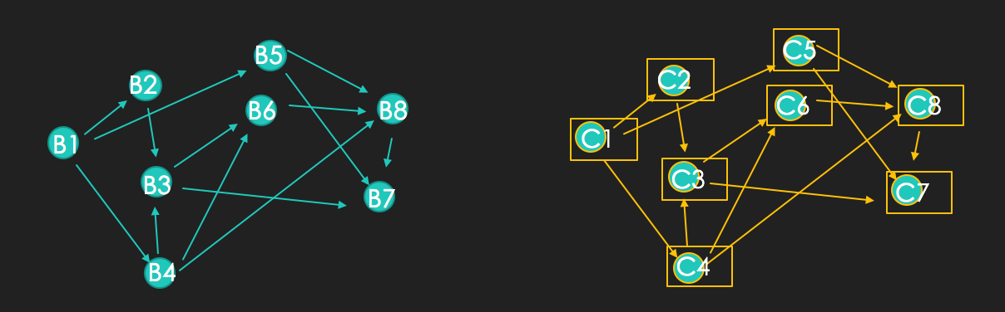

Depth Robust Chaining
C1 = E(KDF(id), B1)
C2 = E(KDF(id, C1), B2)
C4 = E(KDF(id, C1), B4)
C3 = E(KDF(id, C2, C4), B2)
C8 = E(KDF(id, C4, C5, C6), B8)
$C_{i}$ = E(k_{i}, B_{i}) where k_{i} $\text{←}$ KDF(id, $C_{v_{1}}$,.., $C_{v_{m}}$)
for all nodes labelled $B_{v_{j}}$ with edge to node labelled B_{i}

Slide 35
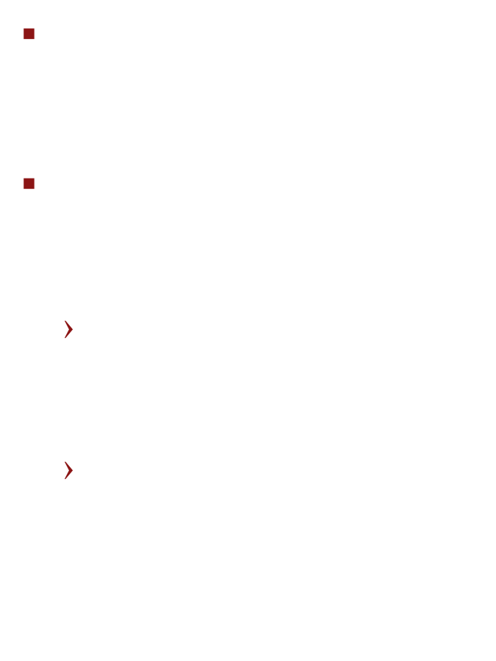
Depth Robust Graphs
Property needed: Depth Robust DAG
Any sufficiently large subgraph of nodes contains a long path
Subgraph $δ$ fraction of nodes contains path length $ε$N
In fact “many” nodes in the subgraph have depth > $ε$N

Slide 36
Depth Robust Graphs
Built from expander graphs [RVW04]
Have degree log(N)
More efficient randomized constructions output DRG with overwhelming probability
Notes:
Reingold, Vadhan, Wigderson

Slide 37
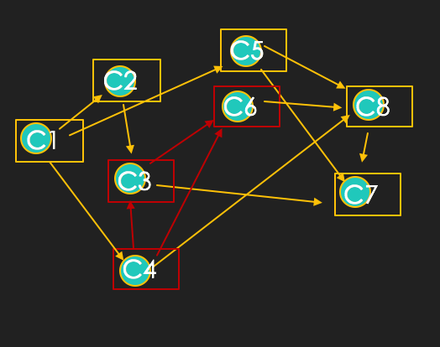
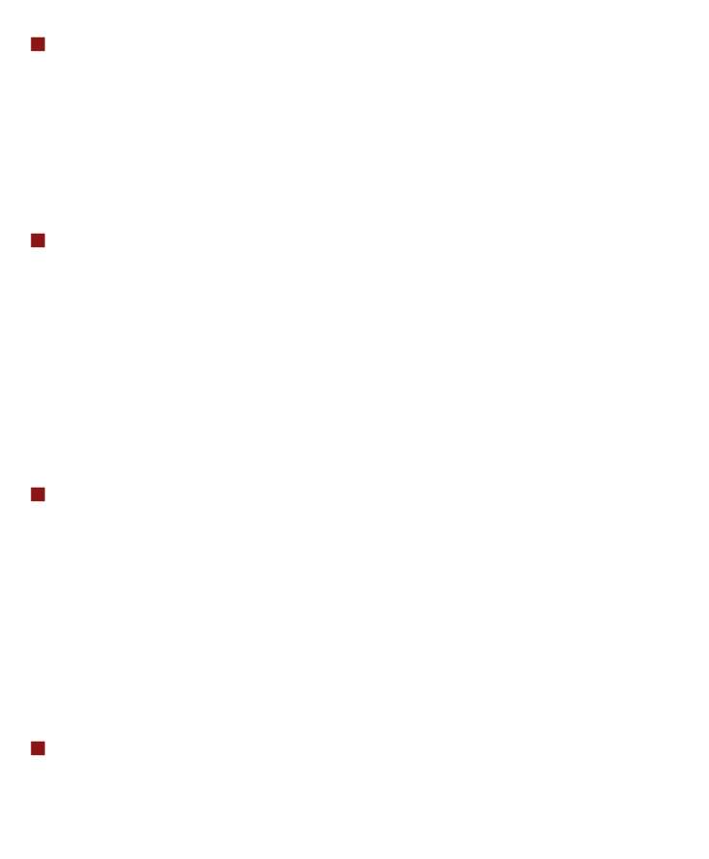
Depth Robust Graphs
Suppose $δ$ fraction of block encodings deleted
High probability random query selects node of “high” depth $ε$N
Answering query correctly requires re-computation of $ε$N encodings sequentially
Set $T_{poll}<εNtenc∈Ω(tsetup$)

Slide 38



Proof of Replication with Depth Robust Chaining
$$Com_{D}$$
Prover
Setup phase
Verifier
Encode
Encode(D, id)
$$\hat{G}(D, id)$$
$$Com_{ \hat{G}(D, id)}$$
$$r_{1},…,r_{k}$$
Challenge phase
Request labels on k nodes and their parents in the graph

Slide 39
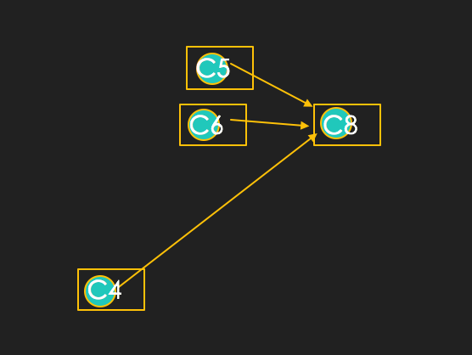

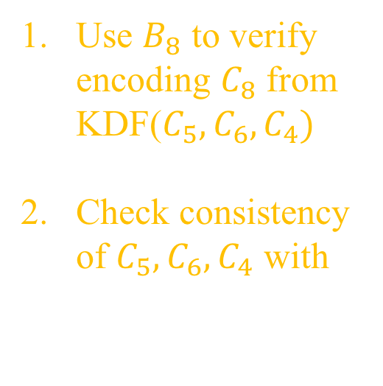
Proof of Replication with Depth Robust Chaining
Verifier
$$Com_{ \hat{G}(D, id)}$$
Use $B_{8}$ to verify encoding $C_{8}$ from KDF($C_{5},C_{6}, C_{4})$
Check consistency of $C_{5},C_{6}, C_{4}$ with $Com_{ \hat{G}(D, id)}$

Slide 40
Summary
We constructed a PoRep secure under a rational adversarial model
Feasible/scalable setup ☺
Constant as file size grows
Low communication ☺
Compact proofs (much smaller than file size)
Infrequent polling
Fast / low complexity verification ☺

